Slide 1

How to Really Use
ChatGPT 4o
Free Version

Slide 2




Notes:
https://www.youtube.com/channel/UC35ZpwldGw7ZJ5R-2sLijzw

Slide 3
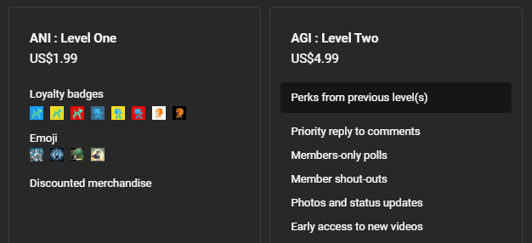
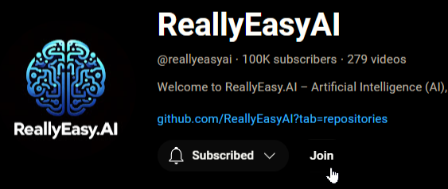
Membership has its privileges
Notes:
https://www.youtube.com/channel/UC35ZpwldGw7ZJ5R-2sLijzw/join

Slide 4

Looking at pictures

Slide 5
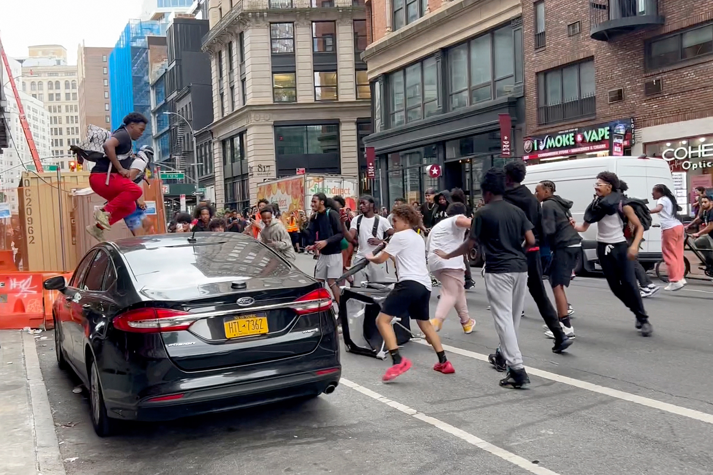
Identification

Slide 6
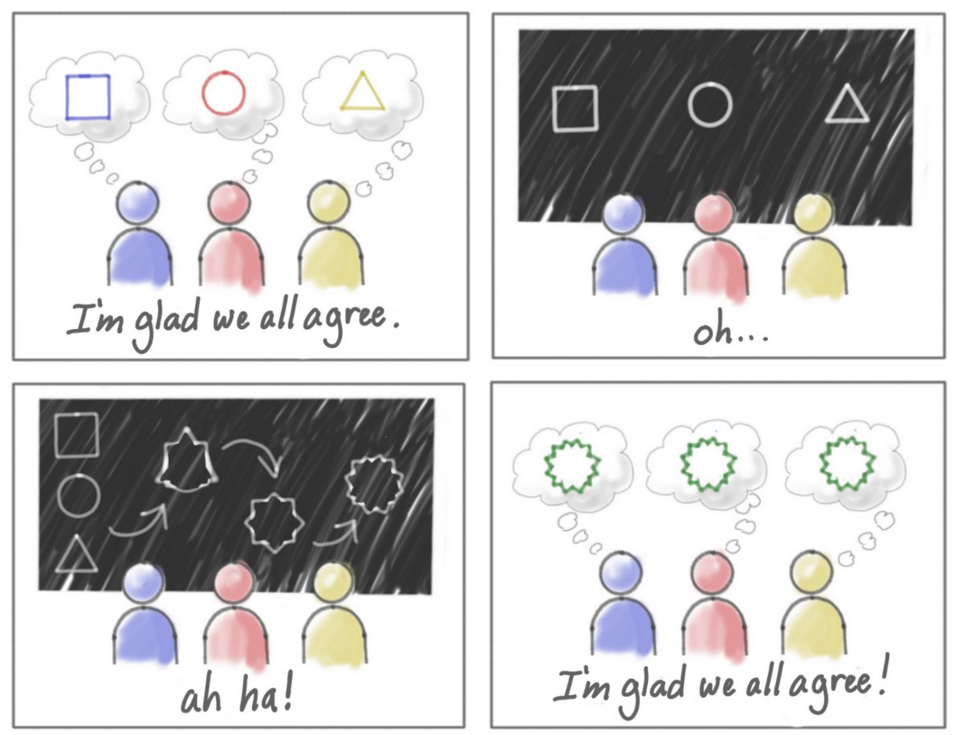
Abstract Ideas

Slide 7
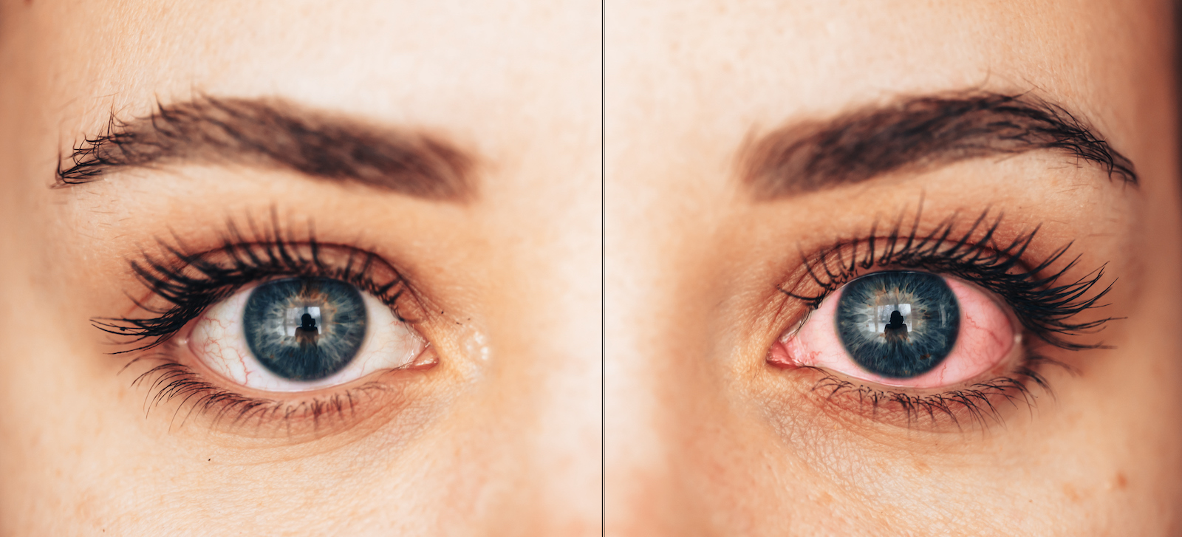
Medical

Slide 8
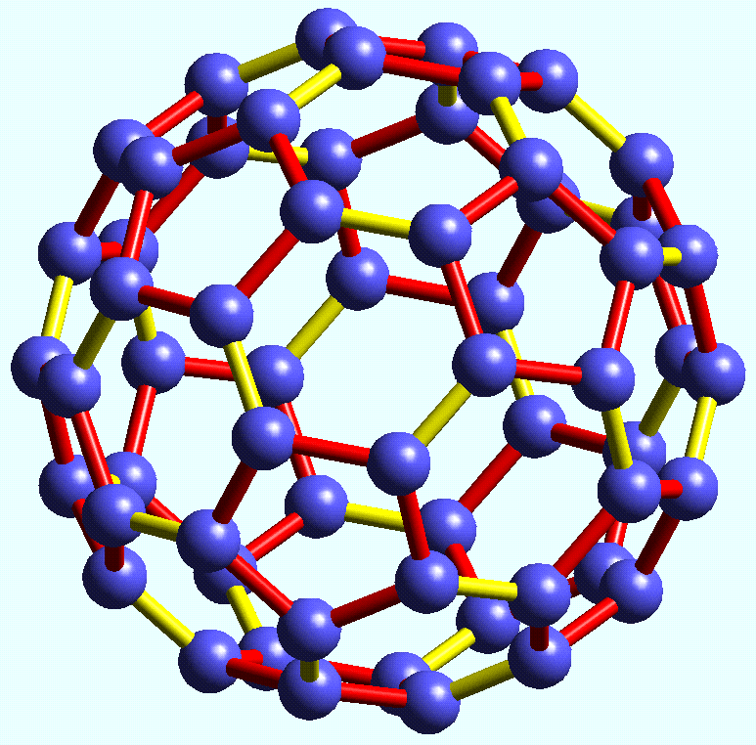
Chemistry

Slide 9
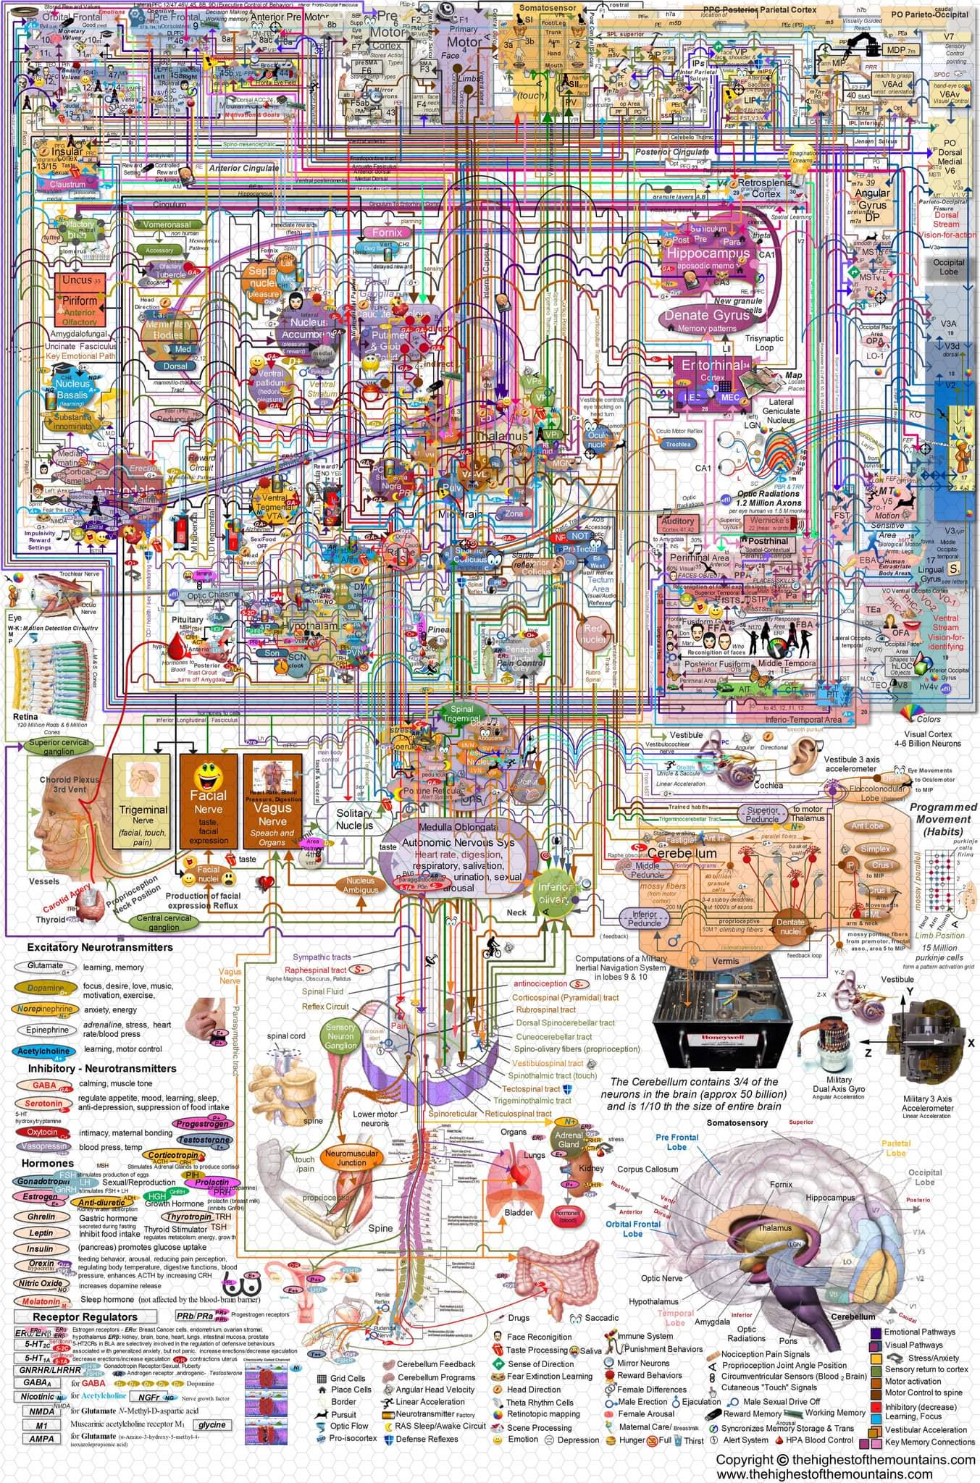
Confusing diagrams

Slide 10
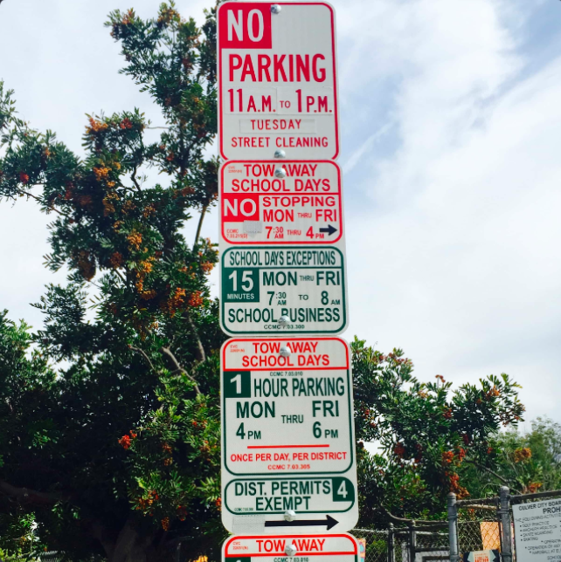
Parking

Slide 11
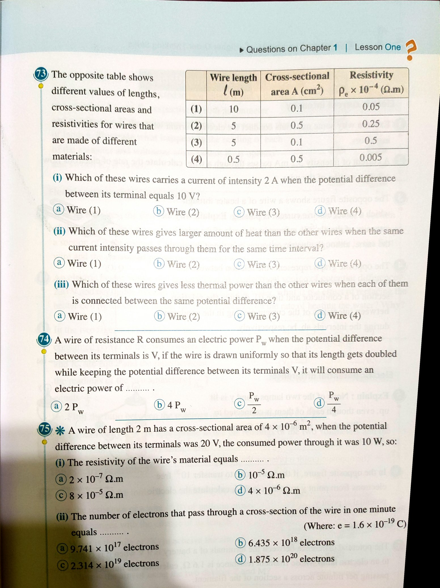
Homework

Slide 12
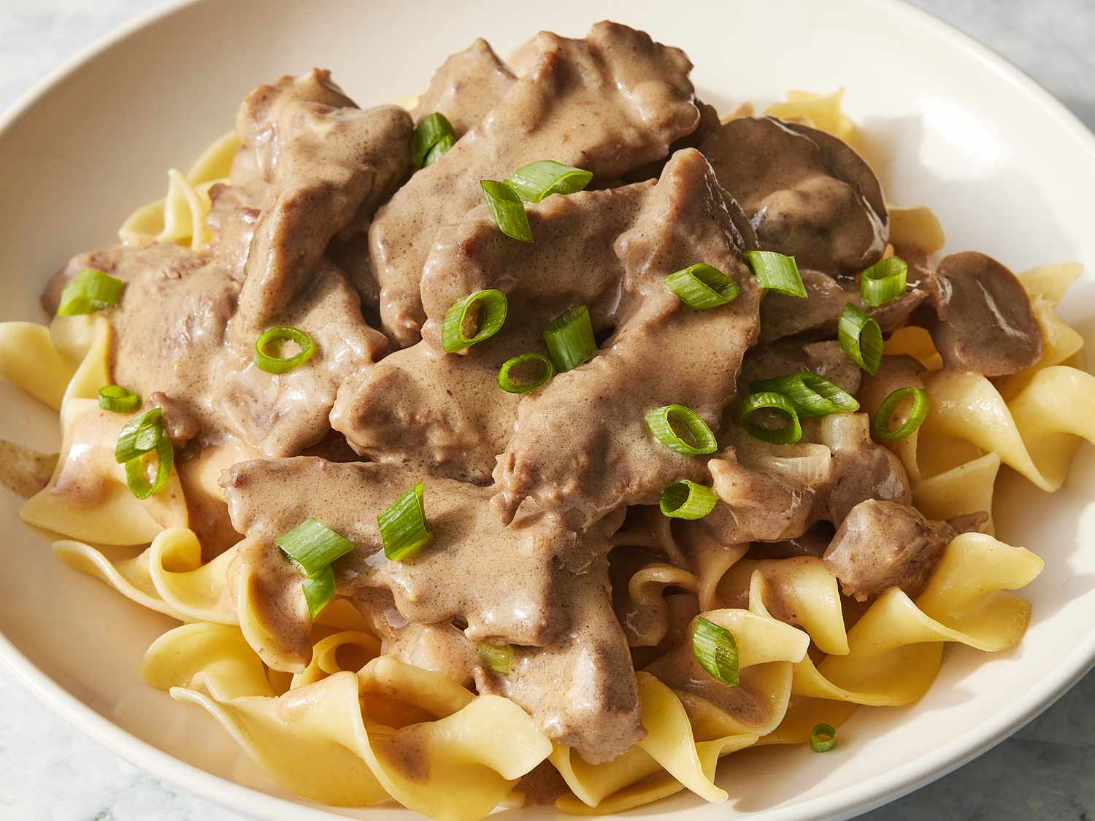
Cooking

Slide 13

Home Decor

Slide 14
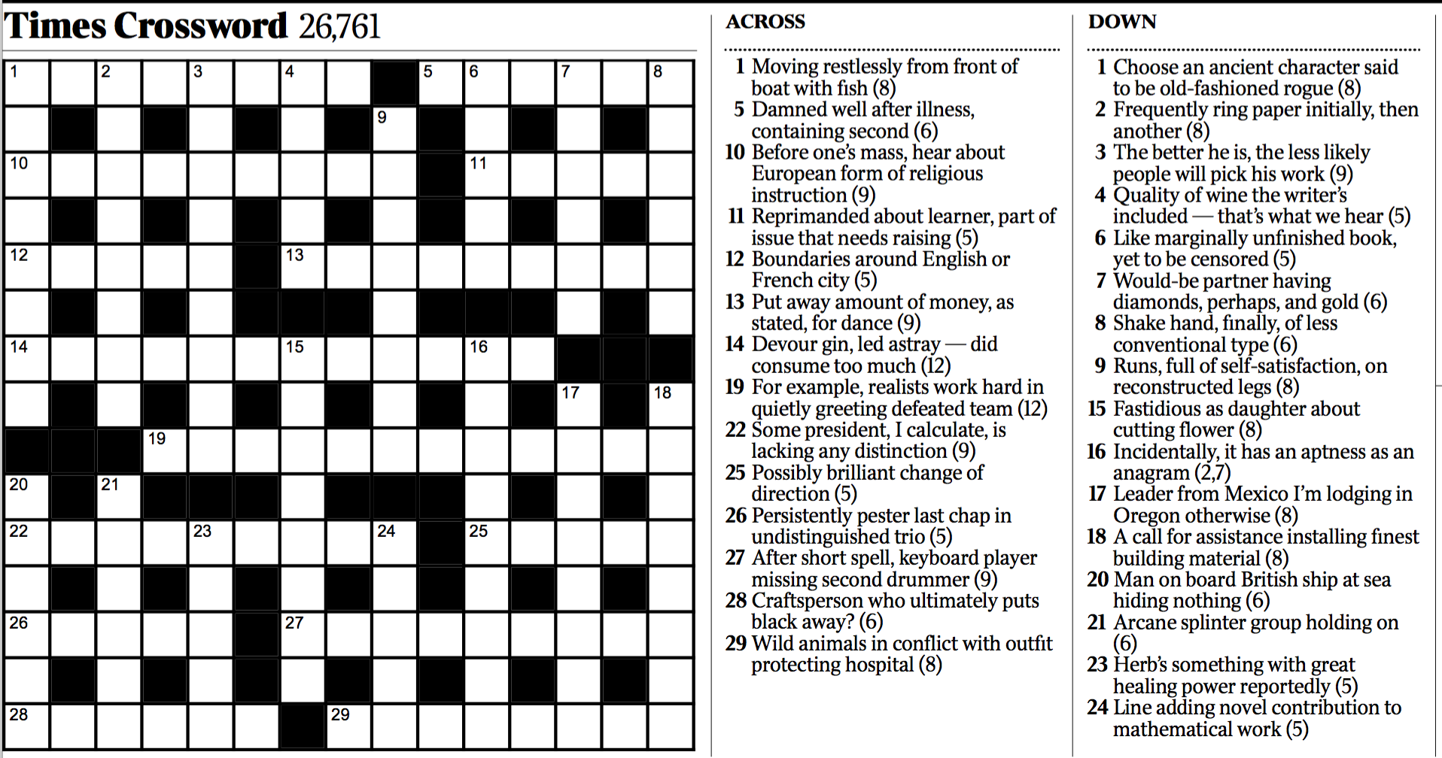
Crossword Puzzle

Slide 15
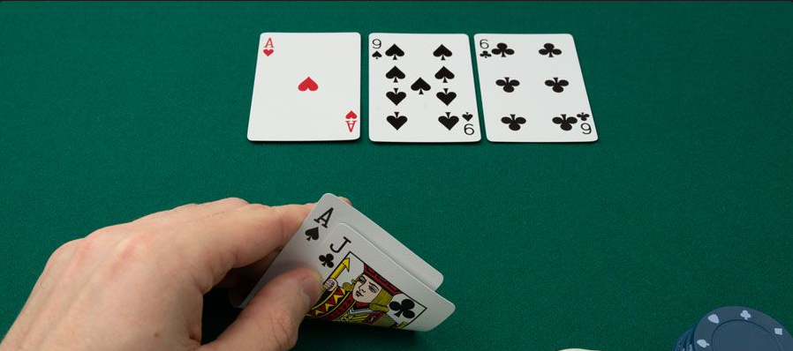
Poker

Slide 16
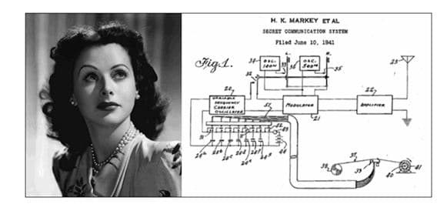
Relationships Between Images

Slide 17
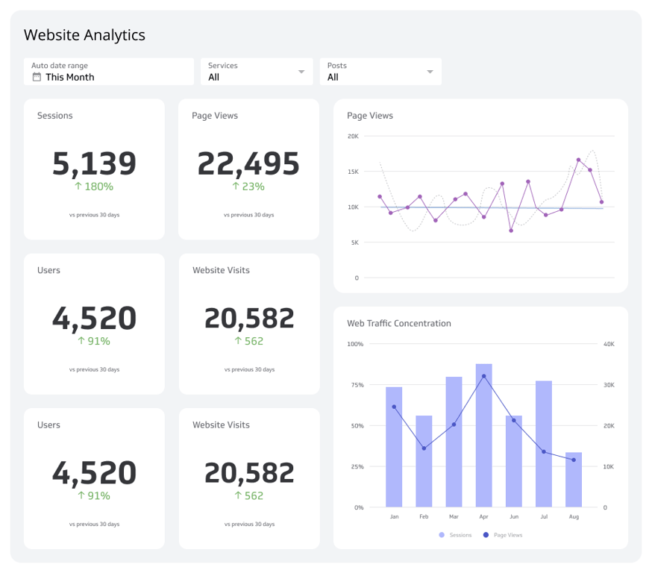
Code

Slide 18
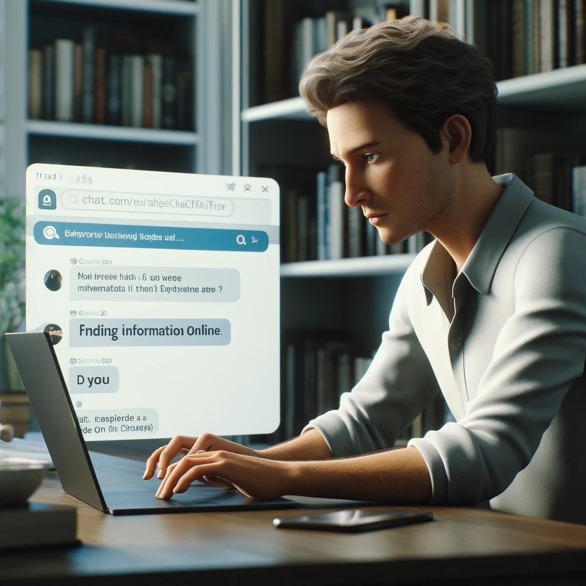
Using the internet

Slide 19
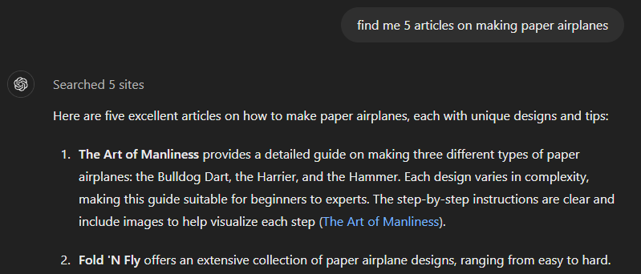
Basic Searching
Notes:
Find me 5 articles on cooking spaghetti

Slide 20
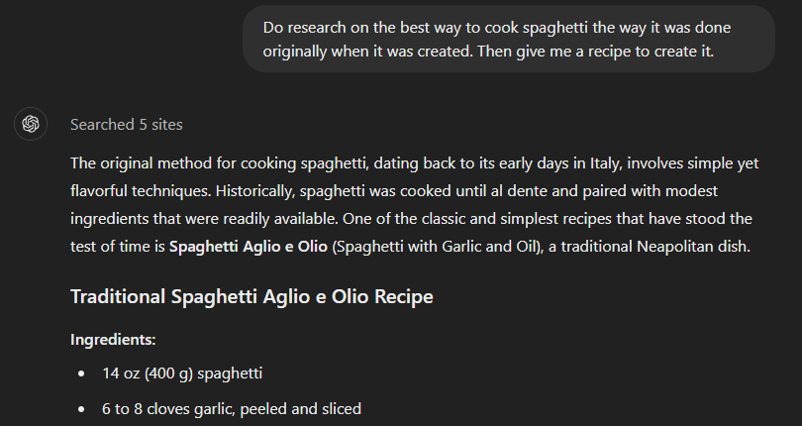
researching and Summarizing
Notes:
I am writing a summary of agentic ai for my boss. I need your help researching about agentic ai.
Please complete the following research task: 1. Find at least 10 articles about the latest developments in agentic ai and ai agents
2. Give me a two paragraph summary of the technology 3. Write a list of 10 key points

Slide 21
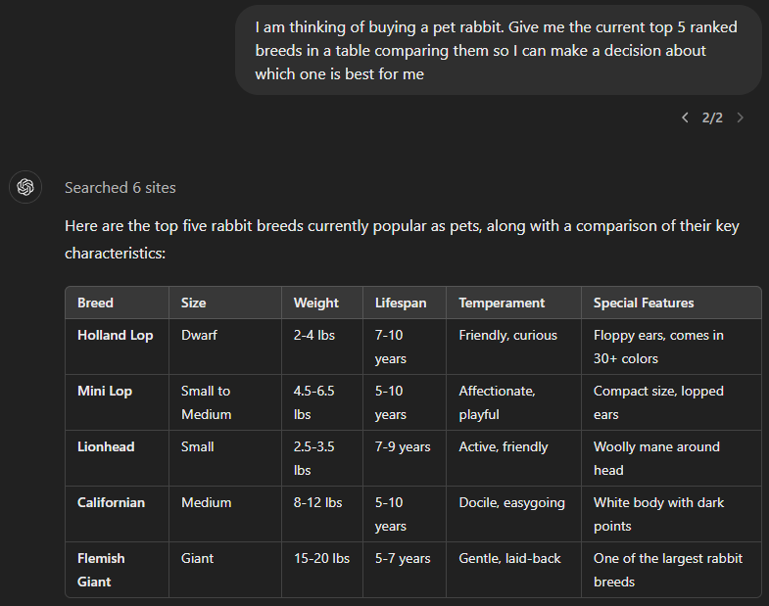
comparisons
Notes:
Look for the top 5 televisions that are 80 inches and below 2000 us dollars. Then give me a table comparing the features so I can make a decision about which one to buy.

